Slide 1




Amplifiers with Negative and Positive Feedback
Team 2: Energon
Presented to -
Mr. Md. Atikul Islam
Lecturer, Department of Computer Science and Engineering
Daffodil International University
1

Slide 2


Our Team
01
Sanzida Akter Nupur
ID: 232-15-759
05
Umme Arifa Zaman Nirjhor
ID: 232-15-695
02
Md Shahinur Kabir Antor
ID: 232-15-159
06
Foysal Mahamud Fahim
ID: 232-15-334
03
Supan Roy
ID: 232-15-716
07
Sharmin Akter Jame
ID: 232-15-380
04
Pallab Debnath
ID: 232-15-676
2

Slide 3


Sanzida Akter Nupur
ID: 232-15-759
Presenter 1
3

Slide 4



Area Covered
Introduction to Amplifiers and Feedback
Negative Feedback Basics, Principle and Gain
Positive Feedback Basics and Gain of Voltage
Mathematical Problems
Advantages of Negative Feedback in Amplifiers
Comparison between Positive and Negative Feedback
Conclusion
4

Slide 5




Introduction to Amplifiers and Feedback
What is an Amplifier?
A device that boosts weak input signals to a higher output level.
Widely used in audio systems, communication devices, and signal processing.
Feedback in Amplifiers
Feedback occurs when a portion of the output is returned to the input.
Purpose: Helps control and improve amplifier performance.
5

Slide 6

Introduction to Amplifiers and Feedback
Types of Feedback
Negative Feedback:
Reduces the overall gain of the amplifier.
Increases stability, reduces distortion, and widens bandwidth.
Positive Feedback:
Increases the amplifier’s gain.
Can lead to oscillations, useful for creating oscillators in circuits.
Importance of Feedback
Essential in designing stable and efficient amplifier circuits.
Choice of feedback type impacts the amplifier's functionality and application.
6

Slide 7
Supan Roy
ID: 232-15-716
Presenter 2
7

Slide 8
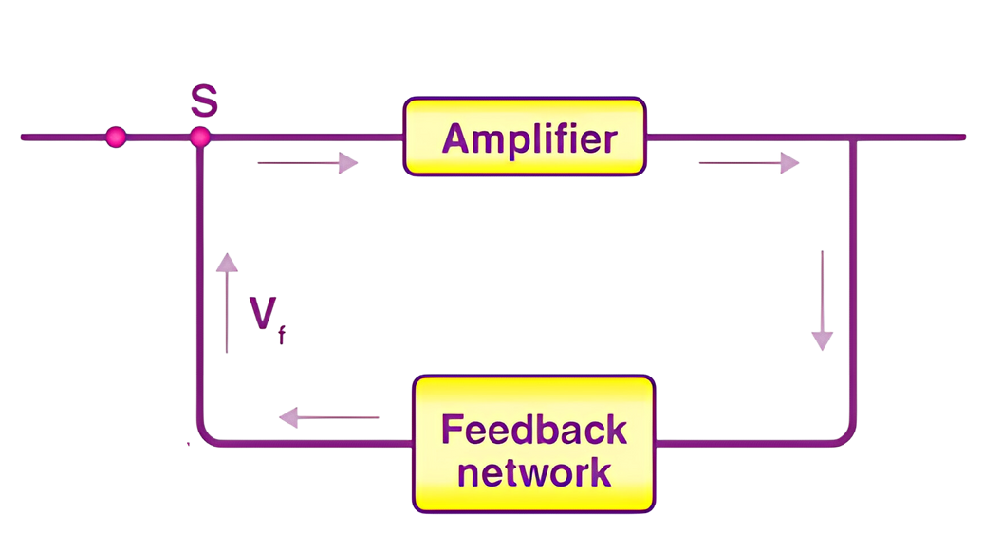

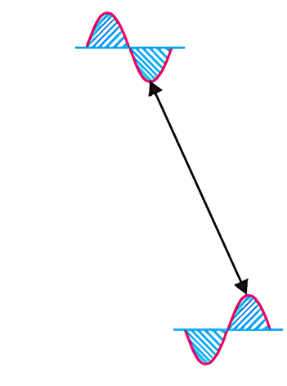


Negative Feedback Basics
Negative feedback occurs when the feedback energy (voltage or current) opposes the input signal.
This happens because the feedback signal is out of phase with the input signal.
How it Works:
The amplifier creates a phase shift of 180° in the circuit.
The feedback network is designed with no additional phase shift (0°), so the feedback signal is 180° out of phase with the input, effectively reducing the input signal.
Introduces 180° Phase Shift
V𝗂𝗇
V𝗈𝗎𝗍
V𝖿 is 180° Out of Phase with V𝗂𝗇
V𝖿
Introduces 0° Phase Shift
Fig. 1
8

Slide 9
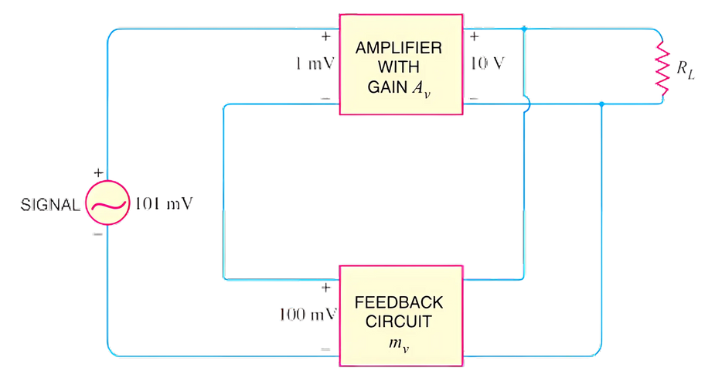
Principles of Negative
Voltage Feedback
In a negative voltage feedback amplifier, a portion of the output (e.g., 100 mV from a 10 V output) is fed back to the input through a feedback circuit, typically made of resistors. When combined with the input signal (101 mV), the effective input becomes 1 mV due to the negative feedback. This stabilizes the amplifier by reducing fluctuations at the input.
Referring to Fig. 2, we have,
Gain of amplifier without feedback,
10 V
=
Fig. 2
A𝗏 =
10,000
1 mV
100 mV
=
0.01
Fraction of output voltage feedback, m𝗏
=
10 V
Gain of amplifier with negative feedback, A𝗏𝖿 =
10 V
=
100
101 mV
9

Slide 10
Foysal Mahamud Fahim
ID: 232-15-334
Presenter 3
10

Slide 11
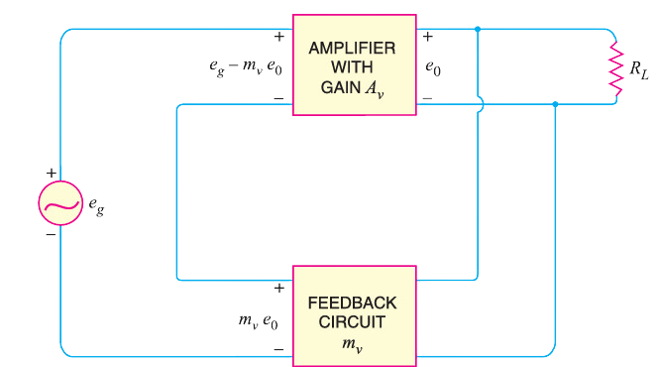
Gain of Negative Voltage Feedback Amplifier
Considering the negative voltage feedback amplifier shown in the Fig. The gain of the amplifier without feedback is A𝗏. Negative feedback is then applied by feeding a fraction m𝗏 of the output voltage e₀ back to amplifier input. Therefore, the actual input to the amplifier is the signal voltage e𝗀 minus feedback voltage m𝗏e₀
Actual input to amplifier = e𝗀 − m𝗏 e₀
The output e₀ must be equal to the input voltage e𝗀 − m𝗏 e₀ multiplied by gain A𝗏 of the amplifier -
(e𝗀 − m𝗏 e₀) A𝗏 = e₀
or, A𝗏e𝗀 − A𝗏m𝗏e₀ = e₀
or, e₀ (1 + A𝗏m𝗏) = A𝗏e𝗀
e₀
Fig. 5
or,
A𝗏
e𝗀
=
1 + A𝗏m𝗏
But e₀/e𝗀 is the voltage gain of the amplifier with feedback.
∴ Voltage gain with negative feedback is
A𝗏
A𝗏𝖿 =
1 + A𝗏m𝗏
11

Slide 12
Sharmin Akter Jame
ID: 232-15-380
Presenter 4
12

Slide 13
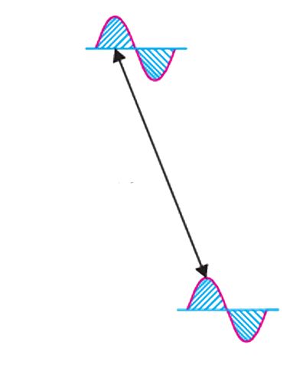
Positive Feedback Basics
Positive feedback occurs when the feedback energy (voltage or current) is in phase with the input signal, reinforcing it rather than opposing it.
This in-phase feedback increases the amplifier’s overall gain.
How it Works:
When the feedback energy (voltage or current) is in phase with the input signal and thus aids it, it is called positive feedback. Both amplifier and feedback network introduce a phase shift of 180°. The result is a 360° phase shift around the loop, causing the feedback voltage V𝖿 to be in phase with the input signal V𝗂𝗇
Introduces 180° Phase Shift
V
out
V
in
V in Phase
with V
f
in
V
f
Fig. 3
Introduces 180° Phase Shift
13

Slide 14
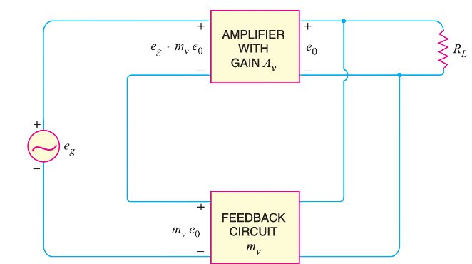
Gain of Positive Voltage Feedback Amplifier
In a positive voltage feedback amplifier, a fraction (mᵥ) of the output (e₀) is fed back to the input, adding to the input signal (e𝗀). This reinforces the input, increasing the overall gain of the amplifier.
+
Actual input to amplifier = e𝗀 + m𝗏 e₀
The output e₀ must be equal to the input voltage e𝗀 + m𝗏 e₀ multiplied by gain A𝗏 of the amplifier -
(e𝗀 + m𝗏 e₀) A𝗏 = e₀
or, A𝗏e𝗀 + A𝗏m𝗏e₀ = e₀
or, e₀ (1 - A𝗏m𝗏) = A𝗏e𝗀
e₀
Fig. 4
or,
A𝗏
e𝗀
=
1 - A𝗏m𝗏
But e₀/e𝗀 is the voltage gain of the amplifier with feedback.
∴ Voltage gain with negative feedback is
A𝗏
A𝗏𝖿 =
1 - A𝗏m𝗏
14

Slide 15
Md Shahinur Kabir Antor
ID: 232-15-159
Presenter 5
15

Slide 16
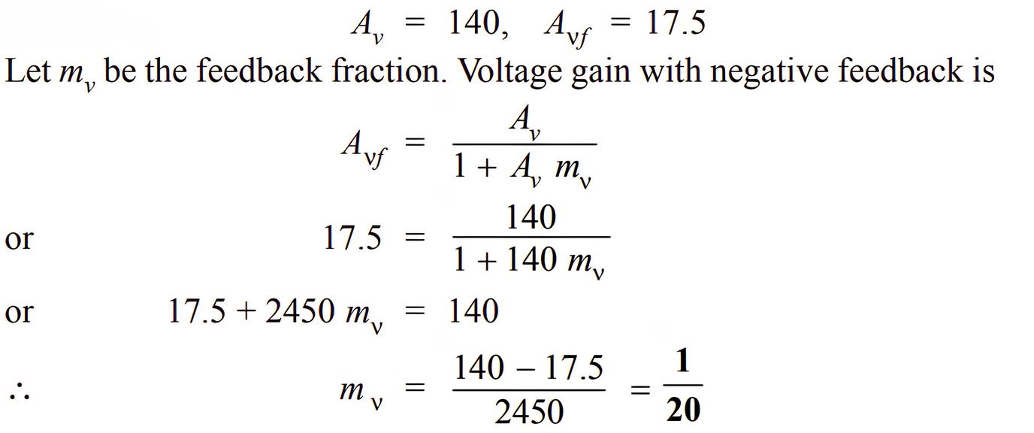
Mathematical Problems
Example 1. The overall gain of a multistage amplifier is 140. When negative voltage feedback is applied, the gain is reduced to 17.5. Find the fraction of the output that is fedback to the input.
Solution.
16

Slide 17
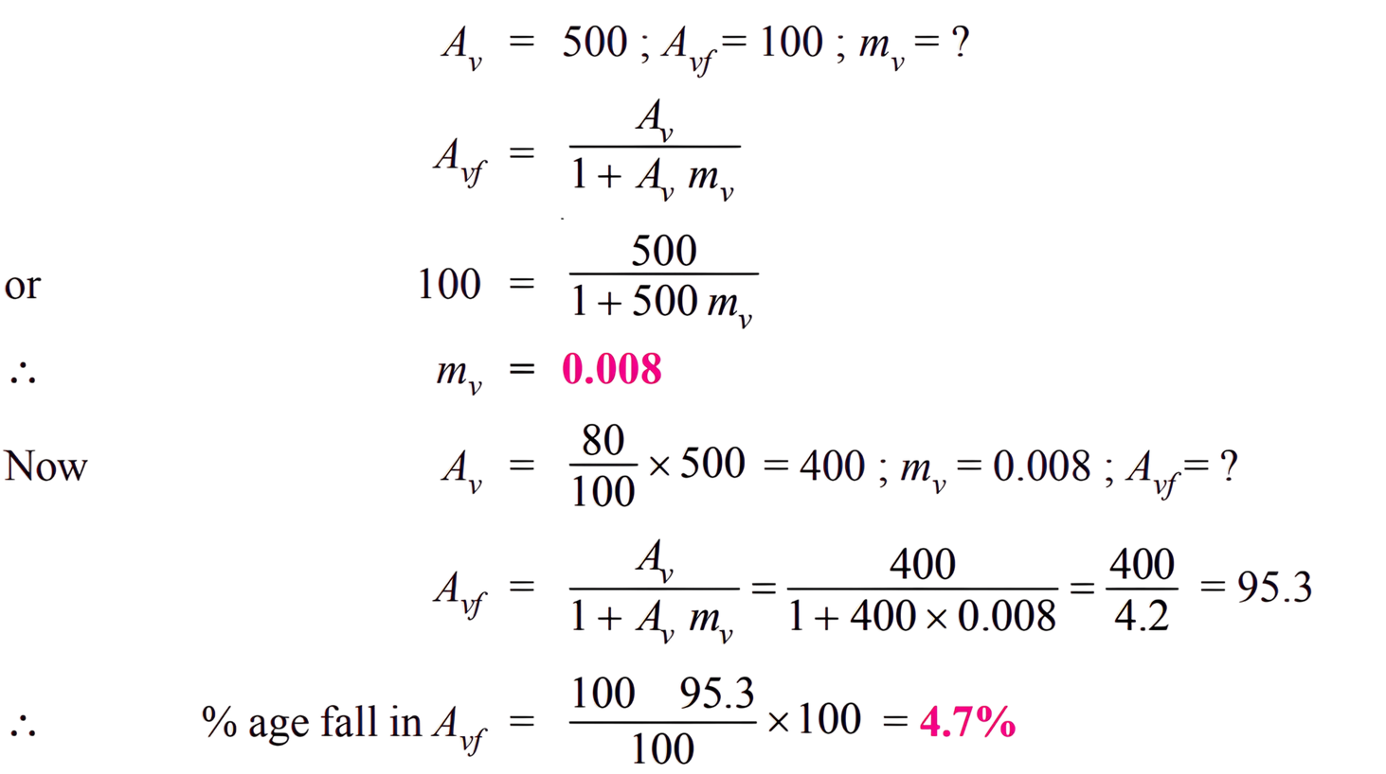
Mathematical Problems
Example 2. An amplifier has a voltage gain of 500 without feedback. If a negative feedback is applied, the gain is reduced to 100. Calculate the fraction of the output fed back. If, due to ageing of components, the gain without feedback falls by 20%, calculate the percentage fall in gain with feedback.
Solution.
-
17

Slide 18
Pallab Debnath
ID: 232-15-676
Presenter 6
18

Slide 19
Advantages of Negative Feedback in Amplifiers
Gain Stability: Maintains a stable gain despite variations in transistor parameters or supply voltage.
Reduces Non-Linear Distortion: Decreases distortion in large-signal amplifiers by a factor of 1 + A𝗏m𝗏​.
Improves Frequency Response: Keeps voltage gain steady across a range of frequencies, enhancing frequency response.
Increases Circuit Stability: Stabilizes output against changes in temperature, frequency, and amplitude.
Increases Input Impedance & Decreases Output Impedance: Facilitates impedance matching, benefiting practical applications.
19

Slide 20
Umme Arifa Zaman Nirjhor
ID: 232-15-695
Presenter 7
20

Slide 21
Comparison between Positive and Negative Feedback
Aspect | Negative Feedback | Positive Feedback
Phase Relationship | Feedback signal is out of phase with the input signal (opposes it). | Feedback signal is in phase with the input signal (reinforces it).
Effect on Gain | Reduces overall gain but increases stability and accuracy. | Increases gain and can lead to oscillations if uncontrolled.
Stability | Improves stability and reduces sensitivity to component changes. | Can reduce stability, often leading to oscillations; useful in oscillators.
Distortion and Noise | Reduces distortion and filters noise; ideal for high-fidelity applications. | Can increase distortion; not typically used where clean signal output is critical.
Typical Applications | Used in audio amplifiers, control systems, and op-amp circuits for stable gain. | Applied in oscillators, Schmitt triggers, and RF amplifiers for signal generation.
21

Slide 22

Feedback Types:
Negative Feedback: Reduces gain, stabilizes performance, and lowers distortion.
Positive Feedback: Increases gain, used for oscillations and signal shaping.
Key Points:
Negative Feedback: Ideal for stable, high-quality output.
Positive Feedback: Useful in circuits needing oscillation, like oscillators and triggers.
Real-World Impact:
Feedback amplifiers are essential in audio, communications, and control systems.
Conclusion
22

Slide 23


Thank You
23

